Slide 1
Final Project
By: Kendall Pliner

Slide 2

Research Question
Will the new pitch clock restrictions effect the players?

Slide 3
Background Information
The MLB has been around for 147 years and every year it seems like the games get even longer. This season they decided to shorten the games to make it more enjoyable for fans by adding the pitch clock. How does this effect the players?
Bases Empty:
Pitchers have 15 seconds to start their motion between pitches. This 15 seconds is measure between the time the ball is thrown back from the catcher to the start of their motion.
Batters must be in the box by the time the clock hits 8 seconds. This means that with no runners on, they have 7 seconds.
Runners on Base:
Pitchers will now have 20 seconds between pitches but there are some more rules to go along with it.
The clock restarts every time a pickoff is attempted
They are only allowed two pickoff attempts/step-offs, on the third attempt/step-off the runner is rewarded the next base.
Those limits reset if the runner advances.
Batters will still have to be in the box by the 8 second mark, which now gives them 12 seconds

Slide 4
Background Information pt.2
General Rules:
If the pitcher violates the clock, a ball is assessed on the batter
If the batter violates the clock, a strike is assessed on them
These can result in a walk for the pitcher or a strikeout for the batter.
Batters are only allowed to call time once
Pitchers and hitters both get 30 seconds between batters.
How this is already affecting the players without looking at the stats:
Pitchers are using this to their advantage and messing with the hitters timing
They have the okay to throw the ball as soon as the hitter engages with them (meaning makes eye contact with them or looks out at the mound)
The batter is only allowed one timeout in their at-bat (which never resets) so some pitchers have been using all 15 seconds and making the hitter antsy and get them out of their rhythm.
Or some pitchers have been mixing it up and throwing some right as the hitter engages and other times waiting all 15 or 20 seconds.

Slide 5
Introduction
The speed of games has been one of the biggest complaints about Major League Baseball. On average one MLB game took 3 hours and 4 minutes. Prior to the 2023 season, the MLB decided to shorten the time between pitches to speed up the game. This left fans and players very skeptical about how it would change the game. But one positive that fans have seen is the change in pace. Now, the average game takes about 2 hours and 38 minutes, a half an hour faster than previous years. Although, this doesn’t show you how this change has affected both the pitchers and batters. I wanted to explore how this would affect all players based on previous years' statistics versus the new pitch clock restrictions. This study uses data from baseballsavant.mlb.com for both pitchers and batters. We will then compare the data sets and conclude how the pitch clock affects players this season and many years to come.

Slide 6
Data
All the data I used was from baseball savant which is also called statcast.
I used 4 data sets overall.
One for 2022 pitch tempo
One for 2023 pitch tempo
Another for 2022 era and batting average
And lastly one for 2023 era and batting average
I had to use the current stats for 2023 because this was the first year with the pitch clock

Slide 7
Test 1: t-test
µ1= 2022 pitch tempo
µ2= 2023 pitch tempo
Hypotheses:
Ho: µ1=µ2
Ha: µ1>µ2

Slide 8
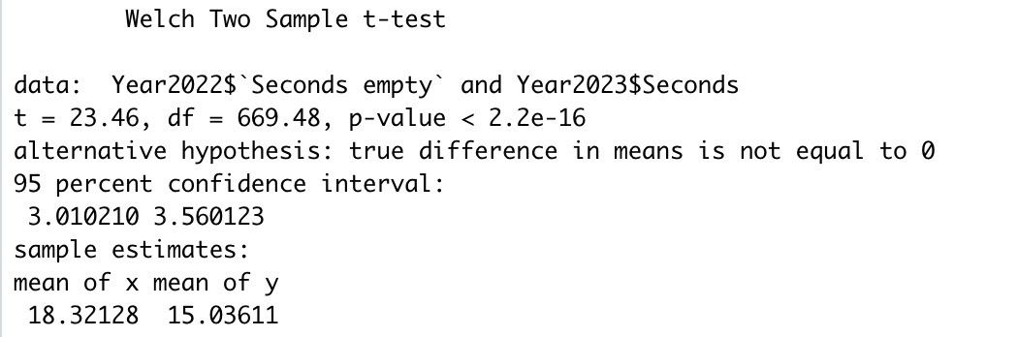
Test 1: t-test
95% Confidence interval:
(3.020210,3.560123)
Testing the difference between the average seconds between pitches from 2022 and 2023

Slide 9
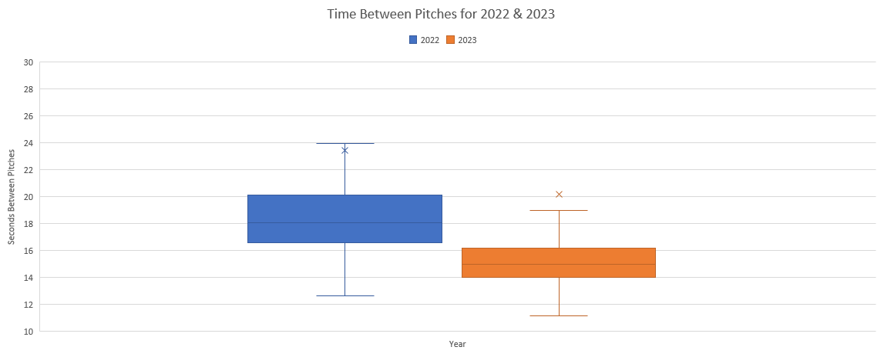
Graph

Slide 10
Test 1 Conclusion
P-value < α
Because the p-value is extremely low, we reject the Null Hypothesis
We are 95% confident that the difference between the two means is between 3.02 and 3.56 seconds

Slide 11
Test 2: t-test
Is there a relationship between era without the pitch clock and era with the pitch clock?
Hypotheses:
Ho: µ1=µ2
Ha: µ1<µ2

Slide 12
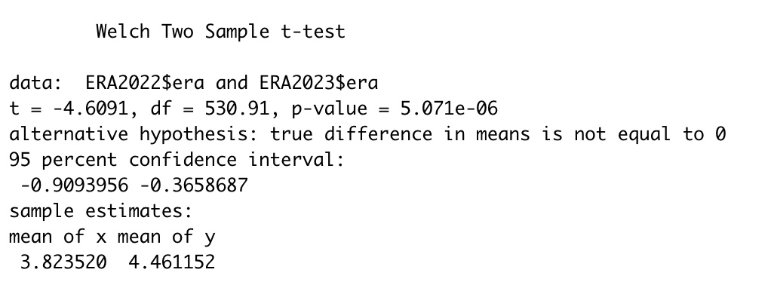
Test 2

Slide 13
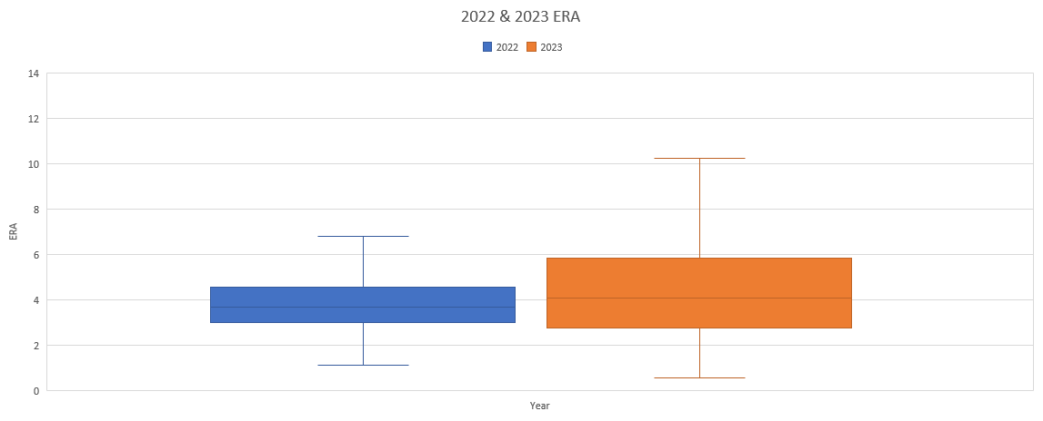
Test 2

Slide 14
Test 2 Conclusion
P-value < α
Because the p-value is low, we reject the Null Hypothesis
We are 95% confident that the difference between the earned run averages(ERA's) of pitchers is 0.909 to 0.36 less than the 2022 season. This means that there is in fact a relationship between era and the pitch clock.

Slide 15
Test 3: t-test
Is there a relationship between batting average against pitchers without the pitch clock and batting average against pitchers with the pitch clock?
Hypotheses:
Ho: µ1=µ2
Ha: µ1<µ2

Slide 16
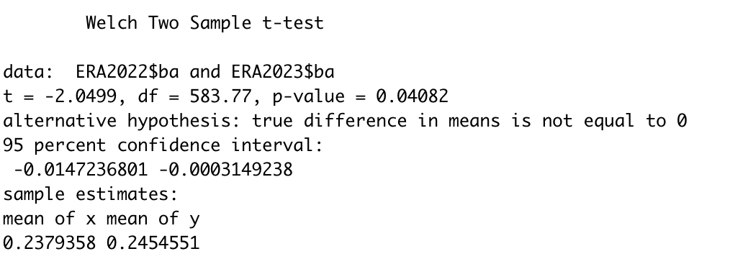
Test 3

Slide 17
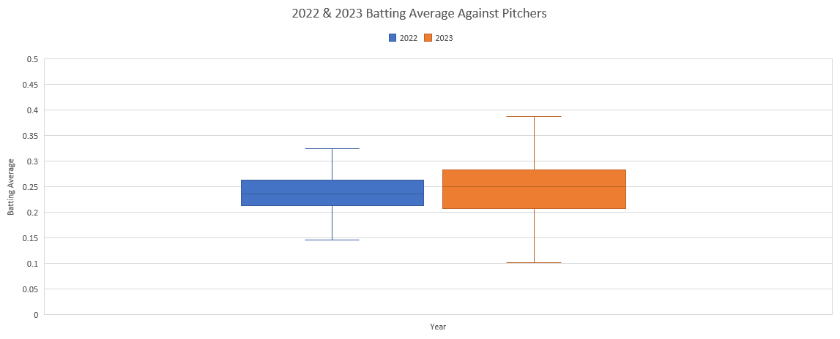
Test 3

Slide 18
Test 3 Conclusion
P-value < α
Because the p-value is less than the alpha value of 0.05, we reject the Null Hypothesis
We are 95% confident that the difference between the batting averages against pitchers in 2023 is 0.015 to 0.00031 less than the 2022 season. This means that there is also a relationship between batting average against pitchers and the pitch clock

Slide 19
Final Conclusion
Overall, all three of my tests supported my alternative hypotheses. This means that the new pitch clock rules have not only affected the amount of time between pitches, but it has also affected the eras of the pitchers. With the ERA's of the pitchers getting higher, the batting averages against them are also getting higher.
If I did this study again:
I would wait and use the data from the entire 2023 season because it's going to change. Which could also affect some of the t-tests I did. Mainly the batting average
I would take any outliers out and clean the data just a little bit more than I already did.
Mainly the players that didn’t pitch more than about a fifth of the season.
I would also take a deeper look into the offensive side of things in terms of batting average of hitters and stolen bases.
I would also look at the amount of violations there has been this year and assess things that way.

Slide 20
Questions??

Slide 21
Sources
https://www.mlb.com/glossary/rules/pitch-timer
https://baseballsavant.mlb.com/leaderboard/expected_statistics?type=pitcher&year=2023&position=&team=&min=q

